Slide 1



Loops, Arrays and Strings
Loops, Arrays, Associative Arrays and Strings
Svetlin Nakov
Technical Trainer
www.nakov.com
Software University
http://softuni.bg

Slide 2


Table of Contents
Loops in JavaScript
while, do-while, for, for-in
Arrays in JavaScript
Declaring and Creating Arrays
Accessing and Processing Array Elements
Associative Arrays, Sorting Arrays
Strings in JavaScript
String Processing Methods
String Concatenation
Escaping, Trimming, Padding

Slide 3

Warning: Not for Absolute Beginners
The "JavaScript Basics" course is NOT for absolute beginners
Take the "C# Basics" course at SoftUni first: https://softuni.bg/courses/csharp-basics
The course is for beginners, but requires previous coding skills
Requirements
Coding skills – entry level
Computer English – entry level
Logical thinking
coding skills
required!

Slide 4

Loops

Slide 5
What Is Loop? Types of Loops in JS
Definition: a loop is a control statement that allows repeating execution of a block of statements
Types of loops in JS
while(…) loop
do { … } while (…) loop
for loop
for-in loop
Infinite loops – a loop that never ends
Nested loops – a composition of loops

Slide 6

while(…) Loop
Repeating a Statement While Given Condition Holds

Slide 7
How To Use While Loop?
The simplest and most frequently used loop
The repeat condition (loop condition)
The condition is evaluated to true or false
5, "non-empty", etc. are evaluated as true
0, "", null are evaluated as false
while (condition) {
statements;
}

Slide 8
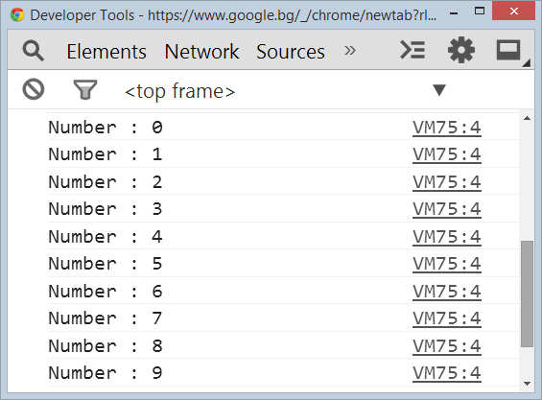
While Loop – Example
var counter = 0;
while (counter < 10) {
console.log('Number : ' + counter);
counter++;
}

Slide 9
Using break Operator
The break operator exits the inner-most loop
var n = 5;
var fact = 1;
var factStr = 'n! = ';
while (true) {
if (n == 1)
break;
factStr += n + '*'
fact *= n;
n--;
}
factStr += '1 = ' + fact;
console.log(factStr);

Slide 10

do { … } while (…) Loop

Slide 11
Using Do-While Loop
Another classical loop structure is:
The block of statements is repeated
While the boolean loop condition holds
The loop is executed at least once
do {
statements;
} while (condition);

Slide 12
Factorial – Example
Calculating N factorial:
var n = 7;
var fact = 1;
var factStr = n + '! = ';
do {
fact *= n;
factStr += n + '*'
n--;
} while (n);
factStr += ' = ' + fact;
console.log(factStr);

Slide 13

for Loop

Slide 14
For Loop – Definition
Initialization
Test
Update
for (var number = 0; number < 10; number++) { // Can use number here } // number is still usable here
Body
Initialization – executed once, just before the loop is entered
Test – checked before each iteration of the loop (loop condition)
Update – executed at each iteration after the loop body
Body – the code that will be executed at each iteration

Slide 15
Simple for Loop – Example
A simple for-loop to print the numbers 0…9:
for (var number = 0; number < 10; number++) {
console.log(number);
}
A simple for-loop to calculate n!:
var factorial = 1;
for (var i = 1; i <= n; i++) {
factorial *= i;
}

Slide 16
Complex for Loop – Example
Complex for-loops may have several counter variables:
Result:
for (var i = 1, sum = 1; i <= 128; i = i * 2, sum += i) {
console.log('i = ' + i + ', sum = ' + sum);
}
i = 1, sum = 1
i = 2, sum = 3
i = 4, sum = 7
i = 8, sum = 15
…

Slide 17

While / Do-While / For Loops
Live Demo

Slide 18

for-in Loop
Iterating over the Properties of an Object

Slide 19
What is for-in Loop?
for-in loop iterates over the properties of an object
For arrays / strings iterates over their indexes (0…length-1)
For any other object, for-in iterates over its properties
Iterating over the elements of an array / string:
var arr = [10, 20, 30, 40, 50];
for (var index in arr) { console.log(arr[index]) }
// 10, 20, 30, 40, 50
var str = "welcome";
for (var index in str) { console.log(str[index]) }
// w, e, l, c, o, m, e

Slide 20
For-in Loop
Iterating over the properties of an object:
Typical mistake is to use the key instead of the value:
var obj = { name: 'Steve', age: 23, location: 'Sofia' };
for (var key in obj) { console.log(obj[key]); }
// Steve, 23 , Sofia
var obj = { name: 'Steve', age: 23, location: 'Sofia' };
for (var key in obj) { console.log(key); }
// name, age, location
var arr = [10, 20, 30, 40, 50];
for (var i in arr) { console.log(i); }
// 0, 1, 2, 3, 4

Slide 21
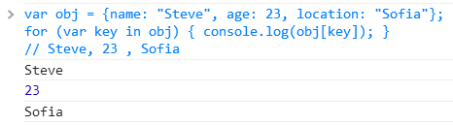
for-in Loop
Live Demo

Slide 22
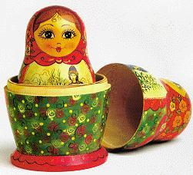
Nested Loops
Using Loop Inside a Loop

Slide 23
What Is Nested Loop?
A composition of loops is called a nested loop
A loop inside another loop
Example:
for (initialization; test; update) {
for (initialization; test; update) {
statements;
}
…
}

Slide 24
Triangle – Example
Print a triangle of numbers:
var n = 5;
var resultStr = '';
for (var row = 1; row <= n; row++) {
for (var col = 1; col <= row; col++) {
resultStr += col + ' ';
}
resultStr += '\n';
}
console.log(resultStr);
1
1 2
1 2 3
…
1 2 3 … n

Slide 25
Primes in Interval [n … m] – Example
var n = 100; var m = 200;
var result = '';
for (var number = n; number <= m; number++) {
var isPrime = true;
var divider = 2;
var maxDivider = Math.sqrt(number);
while (divider <= maxDivider) {
if (number % divider == 0) { isPrime = false; break; }
divider++;
}
if (isPrime) { result += number + ' '; }
}
console.log(result);

Slide 26

Nested Loops
Live Demo

Slide 27

Arrays
Processing Sequences of Elements
Associative Arrays (Key → Value)
Svetlin Nakov
Technical Trainer
www.nakov.com
Software University
http://softuni.bg

Slide 28
Arrays in JS are Objects
JavaScript does not support true arrays.
Arrays in JavaScript are a specialized type of object that supports properties and methods that are normally associated with arrays. (length, push(), join(), pop()…)
var arr = ['one'];
var obj = { 0 : 'one' };
arr[1] = 'two'; // equivalent to arr.push('two')
obj[1] = 'two';
console.log(arr); // [ 'one', 'two' ]
console.log(obj); // { '0': 'one', '1': 'two' }

Slide 29
What are Arrays?
An array is a ordered sequence of elements
The order of the elements is fixed
Can get the current length (Array.length)
In JS arrays can change their size at runtime (add / delete)
Element of an array
0 1 2 3 4
Element index
Array of 5 elements
… | … | … | … | …

Slide 30

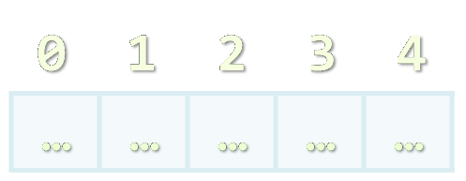

Creating Arrays

Slide 31
Creating Arrays in JavaScript
// Array holding integers
var numbers = [1, 2, 3, 4, 5];
// Array holding strings
var weekDays = ['Monday', 'Tuesday', 'Wednesday',
'Thursday', 'Friday', 'Saturday', 'Sunday'];
// Array of mixed data
var mixedArr = [1, new Date(), 'hello'];
// Array of arrays (matrix)
var matrix = [
['0,0', '0,1', '0,2'],
['1,0', '1,1', '1,2'],
['2,0', '2,1', '2,2']];

Slide 32
Declare and Initialize Arrays
Initializing an array in JavaScript can be done in several ways:
Using new Array(elements):
Using new Array(initialLength):
Using new Array():
Using array literal (recommended):
var arr = new Array(1, 2, 3, 4, 5); // [1, 2, 3, 4, 5]
var arr = new Array(10); // [undefined × 10]
var arr = new Array(); // []
var arr = [1, 2, 3, 4, 5]; // [1, 2, 3, 4, 5]

Slide 33

Accessing Array Elements
Read and Modify Elements by Index

Slide 34
How to Access Array Element?
Array elements are accessed using the [] operator (indexer)
Typically elements are indexed from 0 to arr.length-1
The first element has index 0
The last element has index length-1
Array elements can be retrieved / changed by the [] operator
var arr = [1, 2, 3, 4];
arr[1] = 5;
console.log(arr); // [1, 5, 3, 4]

Slide 35
Reversing an Array – Example
Reversing the elements of an array
var array = [1, 2, 3, 4, 5];
// Get array size
var length = array.length; // 5
// Declare and create the reversed array
var reversed = new Array(length);
// Fill the reversed array
for (var index = 0; index < length; index++) {
reversed[length - index - 1] = array[index];
}

Slide 36


Working with Arrays
Live Demo

Slide 37
Processing Arrays Using for-Loop
Printing array of integers in reversed order:
Initializing all array elements with their corresponding index:
var array = [1, 2, 3, 4, 5];
for (var i = array.length - 1; i >= 0; i--) {
console.log(array[i]);
}
// Result: 5 4 3 2 1
for (var index = 0; index < array.length; index++) {
array[index] = index;
}

Slide 38

Processing Arrays: for-in
How for-in loop works?
i iterates through all the indexes of array
May be used when the indexes are unknown
E.g. to traverse arbitrary object's properties (not array)
All elements are accessed one by one
The order is not guaranteed
for (var i in array)

Slide 39
Traversing Arrays Using for-in – Example
Print all elements of an array of strings:
var capitals = [
'Sofia',
'Washington',
'London',
'Paris'
];
for (var i in capitals) {
console.log(capitals[i]);
}

Slide 40

Processing Arrays
Live Demo

Slide 41
Arrays in JS are Dynamic (Resizable)
All arrays in JavaScript are dynamic (dynamically-resizable)
Their size can be changed at runtime through append / insert / delete
Methods for array manipulation:
array.push(element) – appends a new element at the end
array.pop() – removes and returns the last element
array.unshift(element) – inserts a new element at the beginning of the array
array.shift() – removes and returns the element at the beginning of the array

Slide 42
Append / Insert / Delete from Array
var numbers = [1, 2, 3, 4, 5];
console.log(numbers.join('|')); // result: 1|2|3|4|5
var tail = numbers.pop(); // tail = 5;
console.log(numbers.join('|')); // result: 1|2|3|4
numbers.unshift(0);
console.log(numbers.join('|')); // result: 0|1|2|3|4
var head = numbers.shift(); // head = 0;
console.log(numbers.join('|')); // result: 1|2|3|4

Slide 43
Push / Pop / Unshift / Shift
Live Demo

Slide 44
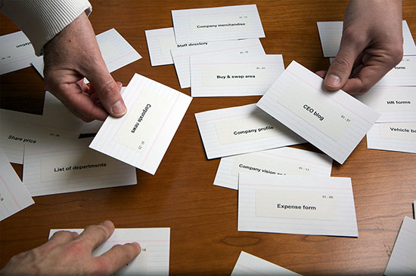
Sorting Arrays
Array.sort() and Array.sort(orderBy)

Slide 45
Sorting Arrays in JavaScript
array.sort()
Sorts the elements of the array (in ascending order)
Compares the elements by their string representation!
i.e. the number 23 is compares as the string "23"
Not quite sorted, right?
var numbers = [5, 4, 2, 3, 1, 4, 5, 6, 7];
numbers.sort();
console.log(numbers.join(', '));
// result: 1, 2, 3, 4, 4, 5, 5, 6, 7
var numbers = [5, 4, 23, 2];
numbers.sort();
console.log(numbers.join(', ')); // result: 2, 23, 4, 5

Slide 46
Sorting Arrays with Compare Function
array.sort(compareFunc)
Sorts element using a compare function
The compare function defines the sorting rules
Return negative or 0 to leave the elements
Return positive to swap them
var numbers = [5, 4, 23, 2];
numbers.sort(function(a, b) {
return a > b;
});
console.log(numbers.join(', '));
// returns 2, 4, 5, 23

Slide 47
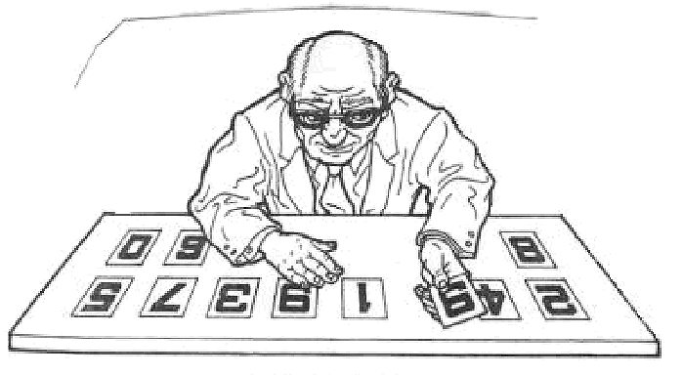
Sorting Arrays
Live Demo

Slide 48
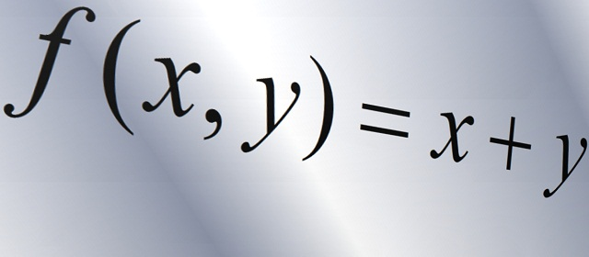
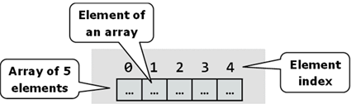
Other Array Functions

Slide 49
Other Array Functions
array.reverse()
Returns a new arrays with elements in reversed order
array.slice(start, end)
Extracts elements from an array (start…end-1)
array.concat(elements)
Appends elements at the end of the array
array.join(separator)
Concatenates the elements of the array

Slide 50
Other Array Functions (2)
array.filter(function(item){ return true / false })
Returns a new array with the elements that satisfy condition
array.forEach(function(item){ … })
Iterates through the array and executes the function for each item
array.indexOf(element)
Returns the index of the first match in the array
Returns -1 is the element is not found
array.lastIndexOf(element)
Returns the index of the first match in the array or -1 (not found)

Slide 51
Other Array Functions
Live Demo

Slide 52
Arrays – Additional Information
Arrays official documentation:
https://developer.mozilla.org/en-US/docs/Web/JavaScript/Reference/Global_Objects/Array
Checking for array
typeof([1, 2, 3]) → object
Array.isArray([1, 2, 3]) → true

Slide 53
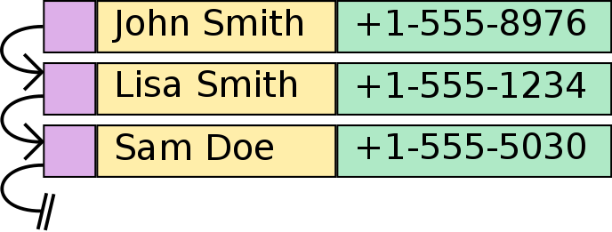
Associative Arrays

Slide 54
Associative Arrays (Maps, Dictionaries)
Associative arrays are arrays indexed by keys
Not by the numbers 0, 1, 2, 3, …
Hold a set of pairs <key, value>
Traditional array
Associative array
key
value
key
0 1 2 3 4
orange | 2.30
apple | 1.50
tomato | 3.80
value
8 | -3 | 12 | 408 | 33

Slide 55
Associative Arrays in JavaScript
Initializing an associative array (object):
Accessing elements by index:
Inserting a new element / deleting element:
Objects are not arrays → no length, no slice(), no join(), …
var prices = { 'orange' : 2.30, 'apple' : 1.50, 'tomato' : 3.80 };
console.log(prices['orange']); // 2.3
prices['cucumber'] = 1.25;
delete prices['orange'];
console.log(prices); // {apple: 1.5, tomato: 3.8, cucumber: 1.25}

Slide 56
Processing Associative Arrays
Processing associative arrays by for-in loop
Taking the keys of object / array:
var prices = {'orange' : 2.30, 'apple' : 1.50, 'tomato' : 3.80 };
for (key in prices) {
console.log(key + ' -> ' + prices[key]);
}
var prices = { 'orange' : 2.30, 'apple' : 1.50, 'tomato' : 3.80 };
console.log(Object.keys(prices)); // ["orange", "apple", "tomato"]
var nums = [10, 20, 30];
console.log(Object.keys(nums)); // ["0", "1", "2"]

Slide 57

Strings
Working with Strings in JavaScript

Slide 58
Strings in JavaScript
A string is a sequence of characters
Text enclosed in single (' ') or double quotes (" ")
var str1 = "Some text in a string variable";
var str2 = 'Text enclosed in single quotes';
String is a primitive type
It is copied / passed by value
String is also immutable
Every time a string is changed, a new string is created

Slide 59
String Methods
string.length
Returns the number of characters in the string
Indexer (string[index])
Gets a single-character string at location index
If index is out of range, returns undefined
string[-1] or string[string.length] → undefined
charAt(index)
Gets a single-character string at location index (just like [])

Slide 60
String Methods (2)
string.concat(anotherString)
Returns a new string – the concatenation of the two strings
string.replace(str1, str2)
Replaces first occurrence of str1 with str2
string.search(regex)
Searches for a substring based on regular expression
var s = 'My mail is email@host.com, please contact me';
var emailIndex = s.search(/\S+@\S+/); // 11

Slide 61
String Methods (3)
string.indexOf(substring [, position])
Returns the left-most occurrence of substring (after the position)
Position is optional and has default value of 0
If string doesn't contain substring, returns -1
string.lastIndexOf(substring [, position])
Returns the right-most occurrence of substring (before position)
Position is optional, default value is string.length
If string doesn't contain substring, returns -1

Slide 62
String Methods (4)
string.substr(start[, length])
Returns a substring by start and length (length is optional)
string.substring(start, end)
Returns a substring, starting from start and ending at end
string.valueOf()
Returns the primitive value of the object string
str.trim(), str.trimLeft(), str.trimRight()
Removes the whitespace from the start / end of the string

Slide 63
String Methods (5)
string.split(separator)
Splits the string by separator and returns an array of strings
Separator can be a regular expression, e.g. s.split(/[\s,]+/)
var tokens = 'C#, Java, PHP ,HTML'.split(',');
// tokens = ['C#', ' Java', ' PHP ', 'HTML']
var tokens = 'C#, Java, PHP;\n JS'.split(/[\s,;]+/);
// tokens = ['C#', 'Java', 'PHP', 'JS']

Slide 64
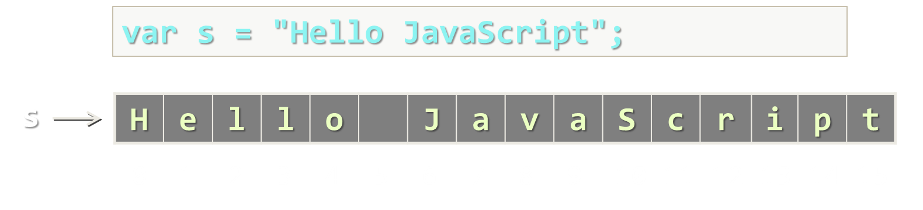
String Methods
Live Demo

Slide 65
String Wrapper
As string is a primitive type, it has a object wrapper type
Primitive types keep only their value
When a property / method is called, the JS engine converts the primitive into its corresponding object type and calls the property
var str = 'sample';
var tempStr = new String(str);
tempStr.length;
var str = 'sample';
str.length;
same as
String.prototype.len2 = function() { return this.length * 2; }
var lenTwice = 'hello'.len2(); // 10

Slide 66
From Object to Primitive Type
JavaScript have a simple parsing from string to number:
Conversion from primitive to object type:
new String('…') creates a string object
String(strObject) creates a primitive string
var str = '42';
var num = Number(str); // 42
var base = 'string'; // "string"
var strObj = new String(base);
// String {0: "s", 1: "t", 2: "r", 3: "i", 4: "n", 5: "g"}
var str = String(strObj); // "string"

Slide 67
String Concatenation
Strings in JS are immutable
Their values cannot be changed - a new string is created
Several ways to concatenate strings:
Concatenating strings is a fast operation in modern browsers
Implemented like a string builder with internal buffering
In old browsers concatenation is slow → use Array.join()
var strConcat1 = str1 + str2;
var strConcat2 = str.concat(str2);
[].push('first', 'second', 'third', …).join('');

Slide 68
String Concatenation
Live Demo

Slide 69

HTML Escaping

Slide 70
String Escaping
What is escaping?
Replacing reserved characters with their escape sequence
Prevents JavaScript injection
When using JavaScript client-side reserved characters are '<', '>', '&', "'" and '"'
document.body.append(
'<script>' +
'document.location = 'http://bad_place.com' +
'</script>');

Slide 71
String Escaping (2)
Escaping is done by just replacing the reserved characters with their escape sequence
Can be attached to the string prototype
String.prototype.htmlEscape = function() {
var escapedStr = String(this).replace(/&/g, '&amp;');
escapedStr = escapedStr.replace(/</g, '&lt;');
escapedStr = escapedStr.replace(/>/g, '&gt;');
escapedStr = escapedStr.replace(/"/g, '&quot;');
escapedStr = escapedStr.replace(/'/g, '&#39');
return escapedStr;
}

Slide 72
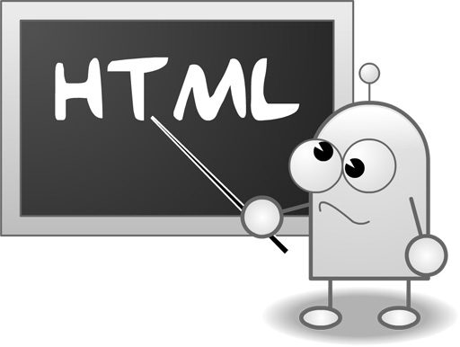
HTML Escaping
Live Demo

Slide 73


Summary
Loops in JavaScript (Same as in C#, Java, C++ )
for-in = foreach by keys / indexes
Arrays in JavaScript
We can have array of elements from different types
Dynamic Arrays, Associative Arrays, Sorting
Strings in JavaScript
String Concatenation, String Wrapper
HTML Escaping
JS Basics

Slide 74







Loops, Arrays and Strings
https://softuni.bg/courses/javascript-basics

Slide 75
License
This course (slides, examples, demos, videos, homework, etc.) is licensed under the "Creative Commons Attribution-NonCommercial-ShareAlike 4.0 International" license
Attribution: this work may contain portions from
“JavaScript Basics" course by Telerik Academy under CC-BY-NC-SA license

Slide 76





Free Trainings @ Software University
Software University Foundation – softuni.org
Software University – High-Quality Education, Profession and Job for Software Developers
softuni.bg
Software University @ Facebook
facebook.com/SoftwareUniversity
Software University @ YouTube
youtube.com/SoftwareUniversity
Software University Forums – forum.softuni.bg

